Slide 1
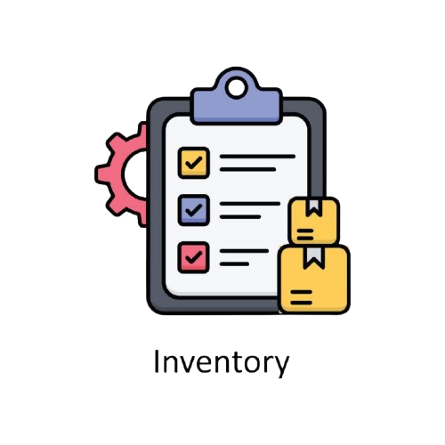

VISUAL PROGRAMMING - LAB
Air University Kamra
INVENTORY MANAGEMENT SYSTEM
Group Members
Faiqa Umar (245161)
Anisa Khan (245215)
Wasif Ali (245187)
Aima (245199)
DEPARTMENT OF COMPUTER SCIENCE | AIR UNIVERSITY – KAMRA CAMPUS

Slide 2



INTRODUCTION
Manual inventory management is time-consuming
Risk of stock mismanagement & errors
Businesses need centralized systems
This project automates inventory & orders
Improves efficiency and accuracy
1/10

Slide 3

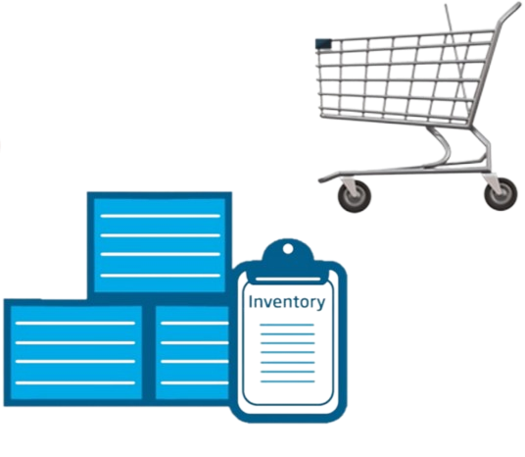

SYSTEM OBJECTIVES
Automate inventory tracking
Provide user-friendly shopping experience
Enable admin to manage products easily
Reduce stock shortages
Maintain secure access control
2/10

Slide 4





SYSTEM ARCHITECTURE
Client-server based architecture
Blazor UI for frontend
App State for state management
Central data handling service
Role-based navigation
3/10

Slide 5



Modules Overview
Authentication Module
Customer Module
Admin Module
Product Management
Order Processing
4/10

Slide 6
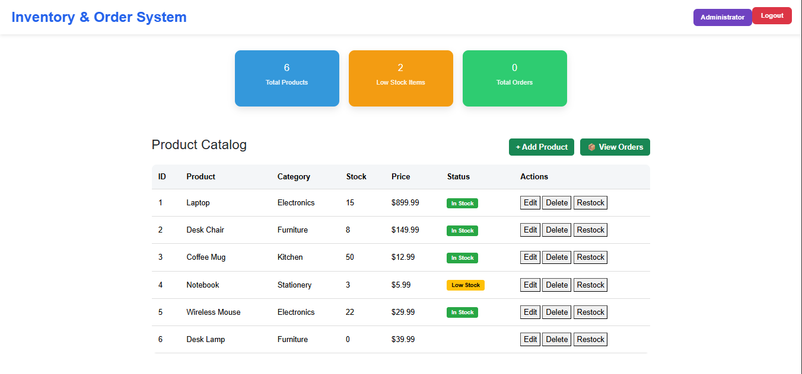
ADMIN PANEL OVERVIEW
Dashboard with statistics
Total products count
Low stock alerts
Total orders view
Quick navigation
5/10

Slide 7
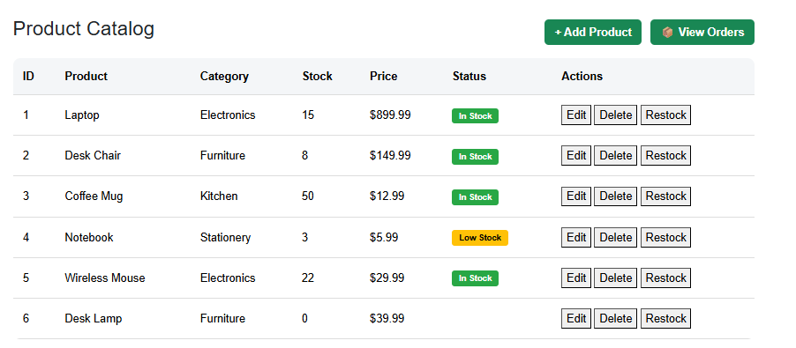
ADMIN PANEL FEATURES
Add new products
Update product details
Delete products
Manage stock levels
View customer orders
6/10

Slide 8
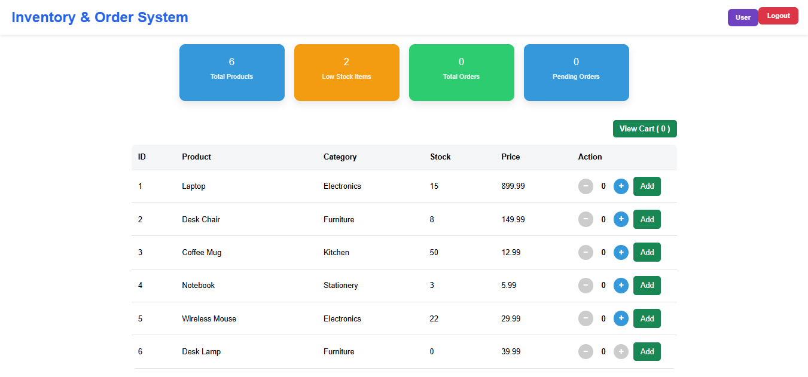
CUSTOMER PANEL OVERVIEW
Product browsing interface
Add products to cart
Quantity management
Checkout process
Order confirmation
7/10

Slide 9
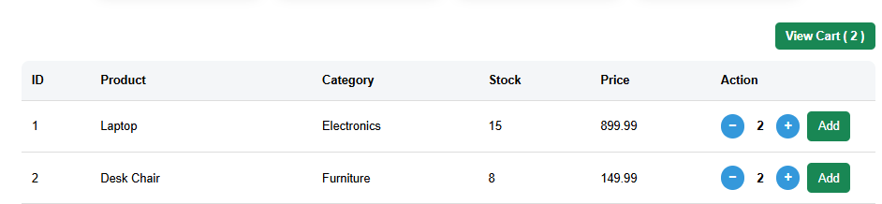
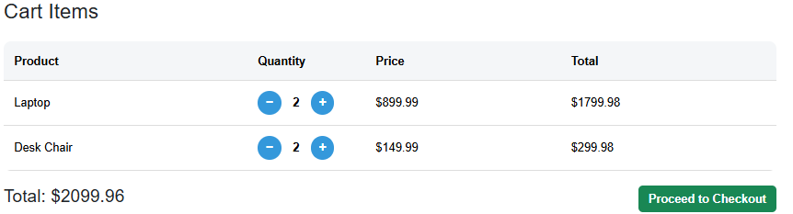
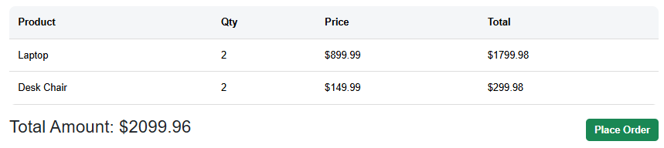
CUSTOMER PANEL FEATURES
View available products
Add / remove cart items
Quantity increment & decrement
Toast notifications
Secure checkout
8/10

Slide 10
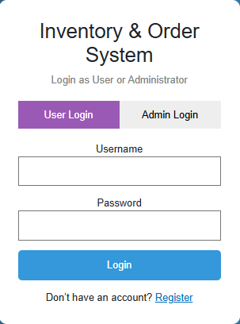




CHALLENGES & SOLUTIONS
Challenges
State synchronization
Role-based access
Cart handling issues
Solutions
AppState management
AuthService authorization
Controlled cart logic
9/10

Slide 11

CONCLUSION
Fully functional inventory system
Improves efficiency & control
User & admin separation achieved
Scalable for future upgrades
Practical real-world application
10/10

Slide 12
THANK YOU

